Slide 1
Sugon Storage Fundamental Products
Moscow, 12/2015

Slide 2
Agenda
1
Product Line Overview
2
Disk Array Products
3
Storage Servers
Notes:
先讲整个IT行业的大背景

Slide 3

TOP 3 Storage Vender in China Market 2014

Slide 4
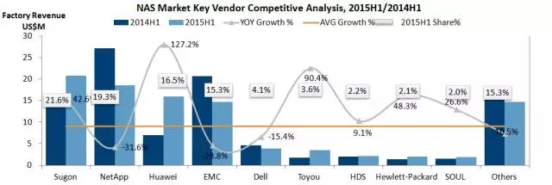
No. 1st NAS Storage Vender in China Market 2014
Sugon ranks the first of NAS market share in 2015H1,
the FIRST TIME that Chinese domestic vendor achieved such result.

Slide 5

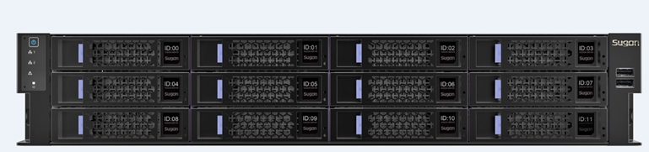
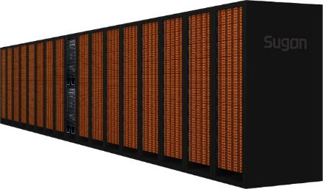
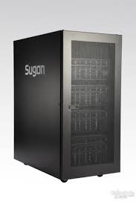
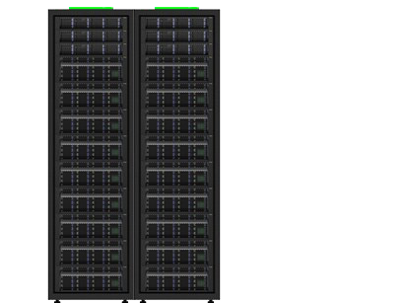


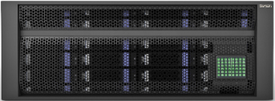
Storage Product Line
Fundamental
Products
Data Protect
Disaster Recovery
Cloud Storage
Big Data Analysis
Standard
Reliability
Scalability
Performance

Slide 6
Agenda
1
Product Line Overview
2
Disk Array Products
3
Storage Servers
Notes:
先讲整个IT行业的大背景

Slide 7


Summary of Disk Array Products
6
5
4
3
2
1
 | Elementary | Middle-Level | High-End | Cluster
 | Single Controller SAN、NAS Unified Storage SAS/SATA HDD Bays 8Gb FC, 10GbE/1GbE Host I/O Ports Optimizated for CCTV Channel Products | Dual-Controller Arch. SAN、NAS Unified Storage SAS/SATA/SSD HDD 8Gb FC、10GbE/1GbE Host I/O Ports High Efficiency, | Qual-Controllers SAS/SATA/SSD HDD 8Gb FC、10Gb/1Gb Host Ports Performance, Scalability Support Snap, Volumn Copy, Volumn Mirror, Storage Pool, Thin Provisioning | Multiple Controller Cluster, Up to 24 Multi-Protocol Unified Storage SAS/SATA/SSD HDD 16Gb FC、10GbE/1GbE、FCoE Host Ports Excellent Scability for Performance and Volumn Various of Advanced Functions
DS900 Series
DS800 Series
DS600 Series
DS200 Series

Slide 8
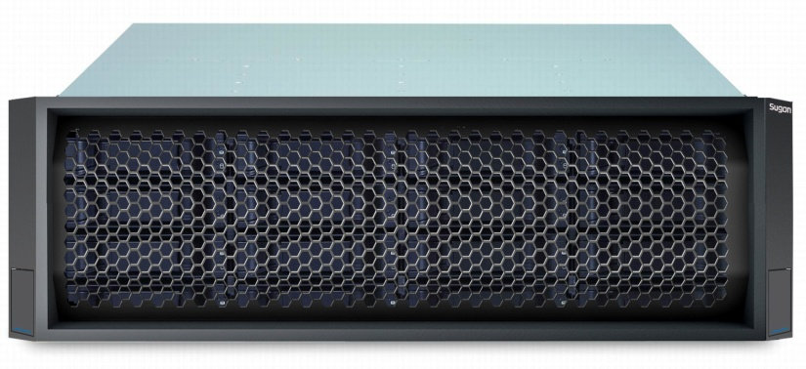
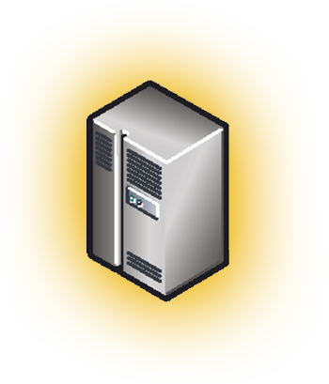
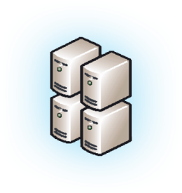


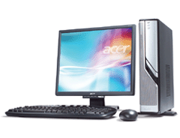

DS200-C20 Overview
Single pluggable controller
64 bit 6-core @ 1.1GHz processer
2GB to 8GB Cache suit for different application
Mix SAS and SATA HDD
Up to 112 Hard disks
2 configurations:
  8 iSCSI/NAS Host I/O Ports
  2 8Gb FC+ 4 iSCSI/NAS Host I/O Ports
Full redundant hardware design, include power, cooling fans
DATA
DATA
DATA
DATA
DATA
DATA
DATA
DATA
Blocks
DATA
DATA
DATA
DATA
DATA
DATA
DATA
DATA
Files

Slide 9
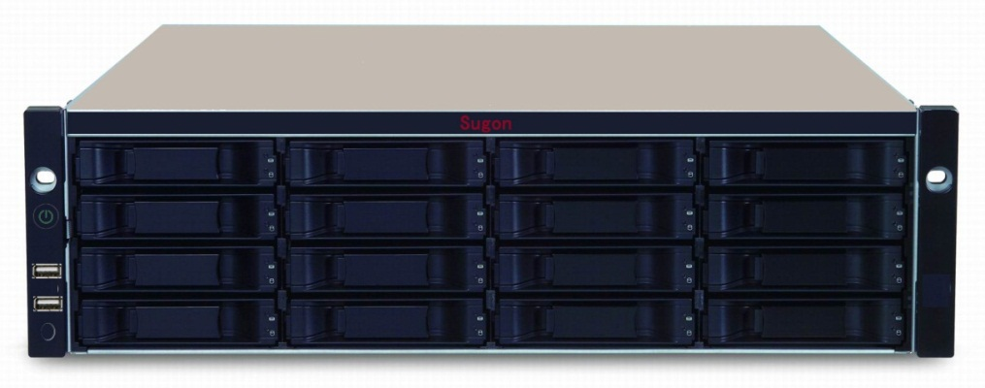

DS600-G20 Summary
Overview
3U 16 HDD Bays, support single/dual controllers, active-active mode
64bit 6core @ 1.1GHz processer
Default 2GB Cache/controller, up to 16GB/controller
Host I/O Ports ( Each Controller):
  Mode 1: 4* 1GbE iSCSI，
  Mode 2: 4* 1GbE iSCSI + 2/4* 8Gb FC/ 2* 10GbE iSCSI
Up to 112 Hard Disk
Data Protection
Predictive Data Migration Technology (PDM)
PRAID technology
72 hours BBU Protect Module
Permanent Flash Protect Module
Online LUN colon
NAS
Support CIFS (MAC, Windows), NFS (Linux/Unix) Protocol
Support Authorization, Quota Management, Online Volumn expansion
Management
Smart Power On/Off
PerfectFlash™ - System Online Upgrade
Plug-in Performance Monitoring System
OAPS智能管理接口
支持网络启动OS
Notes:
先进的PRAID技术将RAID空间划分成单元，对这些单元进行资源的管理，当磁盘内出现部分数据坏块时，其影响的只是坏数据块所在的单元，系统只会针对这个单元进行数据重建，而磁盘的其它数据部分不会受到影响，不仅降低了坏块对系统数据的影响深度，而且将数据重建的效率提高了数倍

Slide 10
DS600-G20 Competitive Edge
3U16 disk, narrow the range of competition
Narrow the range of competition through the hybrid host interface
Shield some low-priced manufacturers
Improve the level of opponent by port number
Supports SAN and NAS functions
3U16 HDD Bays, Host I/O Ports, Multiple Protocols
KeyNote
System
Cache
Price
Bid Requirement
Enhance the level of the opponent by caching
Shield most RISC products
Disk number and cache number to improve the product level of the opponent
Lock competition product
Improve the cost of opponent by specific parameters
Writing favorable price

Slide 11
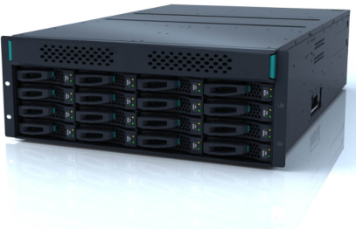
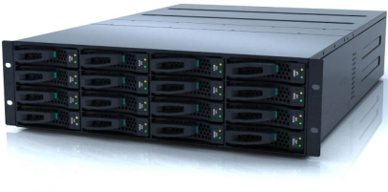
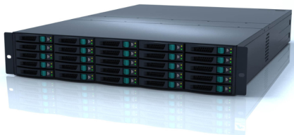
DS800-G25: Storage for Medium Data Center
Configurations：
  Dual-controller：32GB or 64GB Cache
  Quad-controller：128GB Cache, Data Double Write
Architecture：
  PCI-E2.0, SAS2.0
  8Gb FC 、1/10GbE iSCSI Host I/O Card
  Up to 516 Hard Disks
Features
  RAID 2.0, Snapshot, Local Volume Copy, Remote Volume Mirror, Thin provisioning, Quad-controller cluster
DS800-G25 Controller
DS800-G25 3U16 Expansion
DS800-G25 2U25 Expansion

Slide 12

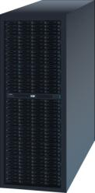
DS800-G25 Powerful Controller Cluster
Redundant for Tolerate 3 controllers failure
Data Center
Host A
Host B
Virtual Volume
In Active-Active mode, Enable Copy/Snapshot function can provide full data protection.
Local Dual Active Mode: provide the failure protection of controllers and device.
Production
Mirror
Mirror
10GE
Engine A
Engine B

Slide 13


Controller Cluster Technology
Data Center
Mirror connection between control engines
Engine A
Engine B
Private
Network
Host A
Host B
SP1
SP1
FC/iSCSI
SP2
SP2
Production
Mirror
10GE
PCI-E
Host I/O Ports: FC or iSCSI
Between the stored image channel with 10GE link, each controller configuration 10GE IO interface card, the optical cross connect
Link length (synchronization distance) no more than 1KM
Active-Active storage solution in one data center
Production
Mirror
Mirror
10GE
Engine A
Engine B

Slide 14






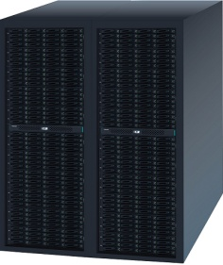

DS800-G25 improve the virtualization efficiency
15 times in Performance with Acceleration On
VMware ESXi & ESX
Virtual SMP
Pro. | Action | Acceleration | Time (Second) | Bandwidth (MB/s)
1GbE iSCSI | Clone | On | 586 | 87
 |  | Off | 8871 | 5.8
 | vMotion | On | 649 | 79
 |  | Off | 7436 | 7
8Gb FC | Clone | On | 120 | 427
 |  | Off | 328 | 156
 | vMotion | On | 110 | 465
 |  | Off | 332 | 155
Support VAAI feature：Full copy, quick reset, intelligent lock
Acceleration of the operation of the virtual machine, such as clone, migration and initialization of the storage layer

Slide 15
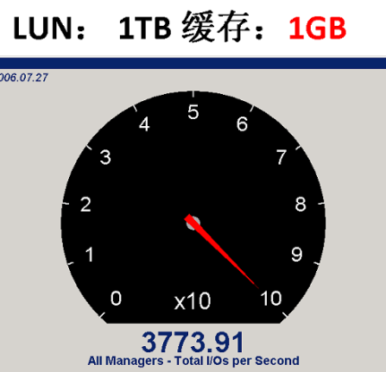
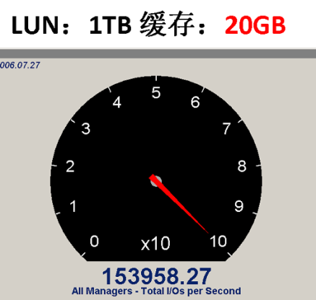
DS800-G25 SSD Cache Acceleration
Level-1 Cache example
Level-2 Cache example
40 times in performance
1GB Cache: IOPS less than 3,800
20GB Cache: IOPS over 150,000
25 times in performance
Before: IOPS less than 1,500
After (200 GB): IOPS over 40,000

Slide 16


DS800-G25 Powerful Raid 2.0
RAID 2.0 Technology
Administrator
Server
LUN0
LUN Virtualization
Partition resource into 1GB blocks
Storage Pool 0
A single RAID can tolerate 3 piece of physical hardware dropped
Storage Pool
Tie0:SSD
Tie1:SAS
Tie2: SAS
Greatly improve the speed of hard disk reconstruction, reducing the risk of data accident
RAID Resource
RAID10
RAID5
RAID6
Disk
Disk
Disk
Disk
Disk
Accurate data bad block warning and processing mechanism to reduce the risk of data accident
Disk
Disk
Disk
Disk
Disk
Physical Storage
…
Disk
Disk
Disk
Low-speed
SAS
SSD
High-speed
SAS

Slide 17
DS800-G25
Models | Sugon DS800-G25 | Huawei 5300V3 | Inspur AS1100H | Comments
Architecture | Dual controller, expand to 4 | Dual controller, expand to 8 | Dual controller | be upgrated in July
Cache/controller | 16/32GB | 16GB | 12GB
Host I/O ports | 4 IO Expansion Slots Up to 8Gb FC ports, 16 1Gb ISCSI ports, 8 10Gb ISCSI ports | 4 IO Expansion Slots, Suport 8Gb/16Gb FC ports，1Gb/10Gb iSCSI, FCoE、Infiniband ports | Up to 8 16Gb FC ports, Up to 8 10Gb iSCSI ports，4 40Gb InfiniBand ports
HDD Bays | SAS,NL_SAS,SSD 516 | SAS,NL_SAS,SSD 500 | SAS,NL_SAS,SSD 384 | HDD numbers
Software | Snapshot, Volume Copy, Automatic streamline configuration, Dual-written 4 controller cluster, Remote copy, Cache acceleration | Snapshot, Volume copy, Automatic streamline configuration, Hierarchical storage, Remote copy, Storage virtualization, Data replication, data compression | Snapshot, Volume copy, Automatic streamline configuration, Cache acceleration, Remote copy | Qual-controller cluster

Slide 18
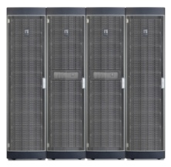
DS900 Core Storage for Enterprise Market
  Multiple controller architecture, up to 8 controller in SAN mode, up to 24 controllers in NAS mode
  A schema supports NAS, FC, FCoE, and iSCSI
  Support SATA, SAS, SSD, Up 1440 HDD in a single system
  Perfect system of disaster recovery technology, the ideal platform for disaster recovery data center and dual active solution
  Support 3rd Part Storage, provide unique management interface
Cluster Architecture,
Unique Storage

Slide 19




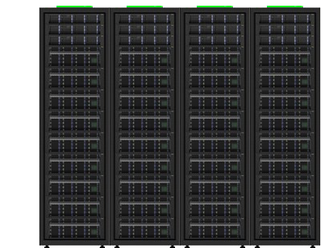
DS900 Advantage: Unique Storage
Streamlined multi protocol integrated storage, supporting multiple types of data and Applications
SAN
SAN
NAS
NAS
FC SAN
Core Database
FC SAN
OA、Email、WEB
Enterprise Core NAS
Virtualization
NAS
File sharing
iSCSI
Ethernet
LAN
FCoE
Fibre
Channel
SAN
(Block)
NAS
(File)

Slide 20

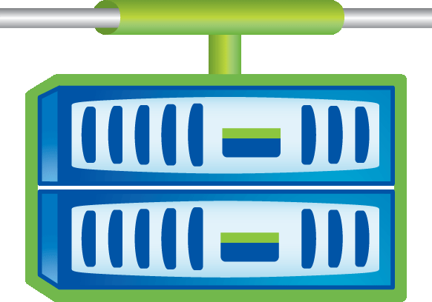
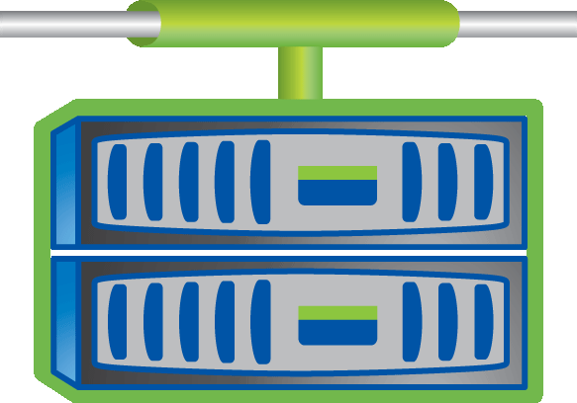
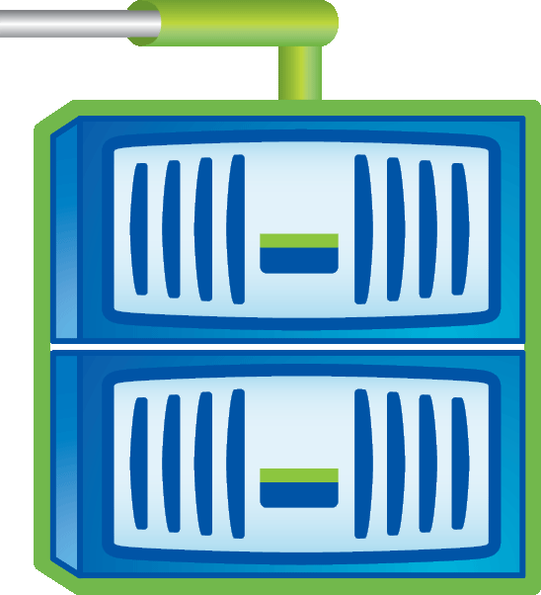
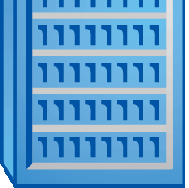





DS900 Advantage: Cluster Architecture
The cluster mode improve the reliability of the system, eliminate the single point of failure, improve the system effectiveness
Heterogeneous clustering:
  According to the work load, many kinds of controllers in a cluster
  Support for heterogeneous disk array integration
  Supports multiple protocol
Hierarchical storage:
  The data and disk cost consistent
  Managing multiple storage layers in one or more namespace
Sample Solutions:
  Reference data
  Disaster recovery image
  OLTP
Projects
A
B
C
A1
A2
A3
B1
B2
C1
C2
C3
B
C2
C3
A3
C1
C
B2
A2
B1
A1
High Speed Storage
(Balance the performance )
Larger Capacity
（Lower the cost）

Slide 21



DS900 Advantage: Acceleration
Multiple levels caching mechanism, support read and write performance acceleration, greatly improve the operating efficiency of the virtualization
Controller
Level
Cache acceleration with flash technology
Flash Cache
Disk Array
Level
Flash Pool
SSD: Cache and persistence

Slide 22
DS900 Advantage: Improve the Space Utilization
De-duplication and Data Compress, improve the storage space utilization
Post
Procedure
Online
After Data Compress
De-duplication with Compress
Original Data
Key Features
Enterprise Reward
Higher efficiency and support for more work load
Improve writing performance
Promote the investment value
Extensive customer suitability

Slide 23
DS900 Summary
Support cluster mode, full follow-up of performance and capacity expansion needs of customers
A host can support SAN and NAS architecture network, high integration, better performance and reliability, and management uses a simple
Supports multi-level caching mechanism (PCI-E SSD,SSD), and supports both read and write performance speed
For virtualization business with VAAI, SRM interface and performance improvements, building disaster tolerant scheme of cloud platform
Data De-duplication and compression, usable, effectively improve the efficient use of storage space

Slide 24





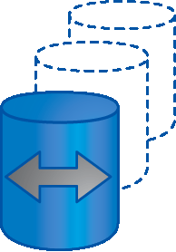











DS900 Disaster Recovery Technology
Main Data Center/
Management
Monitoring
Application Proxy
Metrocluster
Disaster recovery center
SnapMirror
Snapshot
a clone for development and testing
SnapVault
Backup
archive Software
Data compliance
Remote Office
SnapVault
Backup

Slide 25




DS900 Dual Active Data Center Solutions
Production
DR center
LAN/SAN
Disks
Configuration:
A system of remote connection
A set of main cabinet, requires a minimum of 2 expansion Cabinet
Data is written to both the two locker
Support business continuity of higher

Slide 26
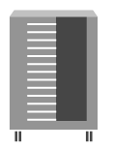


DS900 Nearby Dual Active Data Center Solution
Node 1
Node 2
Nearby MetroCluster
50 meters
Volume X
Volume Y
Volume Y Mirror
Inner Data Center
Volume X Mirror

Slide 27


DS900 Distributed Dual Active Data Center
Building
A
Building
B
Long Distance MetroCluster
<=200 kilometers
DWDM
Fibre Links
DWDM
Volume X
Volume Y
4 FC-SAS switchs
FC switch
Volume Y mirror
Volume X Mirror

Slide 28
DS900 Redundant Distributed Data Center
City A
Backup Data Center
Production Data Center
DB Cluster
BD Cluster
VM Cluster
VM Cluster
ParaStor200 remote synchrize
MetroCluster/Synchronous mirroring
SnapMirror/Asynchronous replication
ParaStor200
DS900
DS900
ParaStor200
Remote DR Center
City B
DS900
Virtualization

Slide 29
DS900 Disaster Recovery Summary
DS900 disaster recovery environment advantage
  Unified storage products, building storage dual live solution and supports SAN, NAS architecture network, competitor’s solution typically support SAN architecture only
  Provide remote volume mirroring and MetroCluster dual live solution selection, meet the needs depending on distance and network environment of the users
  Competitors’solutions normally use the virtualization storage gateway + 2 sets of disk array architecture, add another layer of fault, and its cost is not low
DS900 disaster recovery environment advantage
  No disadvantage

Slide 30
Agenda
1
Product Line Overview
2
Disk Array Products
3
Storage Servers
Notes:
先讲整个IT行业的大背景

Slide 31

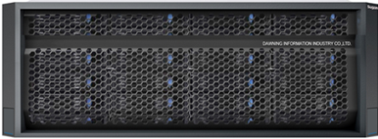

Summary of Storage Server
6
5
4
3
2
1
 | Elementary | Middle-Level | Alternative | High-End
 | 4U 24/36 2 models SATA/SAS/SSD Support single processor 4 Unbuffer DDR3 slots,，up to 32 GB RAID0/1/5/6/10/50 | 4U 24/36, 3 models SAS/SATA/SSD Support Intel E5-2600 v2 series Up to 512GB DDR3 Memory RAID0/1/5/6/10/50 | 4U 24/36, 3 models SAS/SATA/SSD Support Intel E5-2600 v3 series Up to 1.5TB DDR4 Memory RAID 0/1/5/6 Support SAS 3.0、PCIe 3.0 | 5U, up to 88 HDD Bays SAS/SATA/SSD Support Intel E5-2600 v3 series Up to 384GB DDR4 Memory RAID0、1、5、1E、10 Support SAS 3.0、PCIe 3.0
S650-G20
S640-G20
I640-G15
I240-G20

Slide 32
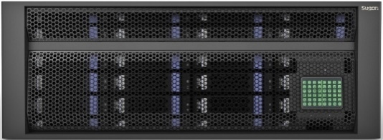
New Storage Server: S640-G20
Performance
Intel Xeon E5-2600 V3 Series processer, up to 18 cores
Integrated 4 channels memory controller, up to 2133 MHz DDR4 memory
Support SAS 3.0, PCIe 3.0 Technology
Scalability
Up to 24/36 HDD Bays, support SATA/SAS/SSD Hard Disk,
Up to 216 TB per server using 6TB SATA
Up to 24*DIMM, Maximum to 1.5TB memory
Up to 8 PCIe 3.0 Slots, support full-size high speed cards
Reliability
Redundant power supplement module and cooling fans
Power and disk support hot swap to guarantee the high reliability of the system
High efficiency cooling design, prolong the life of components, reduce the cost

Slide 33
New Storage Server: S650-G20
Hardware Sale
Key: Price
Occupy some market of 4U24/36, advantage of price per TB
No disadvantage with competitors 'productions in price
Increase Margin
Key: Customized
Reconfiguration and optimization with customers’ Applications
Closely tied up with the applications, Integrated Solutions
Key Feature
Destination Market
Big Customers
5U 88 HDD Bays
Super High Density
Extreme I/O Bandwidth
Massive Storage
Storage Node in Cloud Storage
Main fields: Internet, TV & Broadcasting, Telecom
Application: Cloud Disk, Video-online, Navigations, IPTV, Cloud Storage
Price competition
Assigned Person
In-depth communications with the customers , specifically optimized

Slide 34

EB-Class Storage System
ParaStor 200
Reliability
Usability
Safety
Massive
Performance
Reliability
Unstructured
Massive storage for unstructured data , unlimited expansion
16PB
Largest capacity in China
N GB
Aggregate bandwidth N*1GB
90%
Utilization Radio
(N+M)
45%
Reduce overall TCO
Notes:
ParaStor200 system consists of four types of components: the index controller oPara, the data controller oStor, the management controller MGR and the client-side of application server oApp, among which, the index controller is used to manage all the index data and namespaces of the storage systems and provide the external with simplex global namespace; the data controller is used to provide the data storage space and realize the concurrent access of files – it can support both replication and N+M fault-tolerant mechanisms; the management controller provides a unified control and management interface, through which, the administrator manage the entire storage system; and the client-side of application server provides the data access interface to the upper level application.

